Slide 1




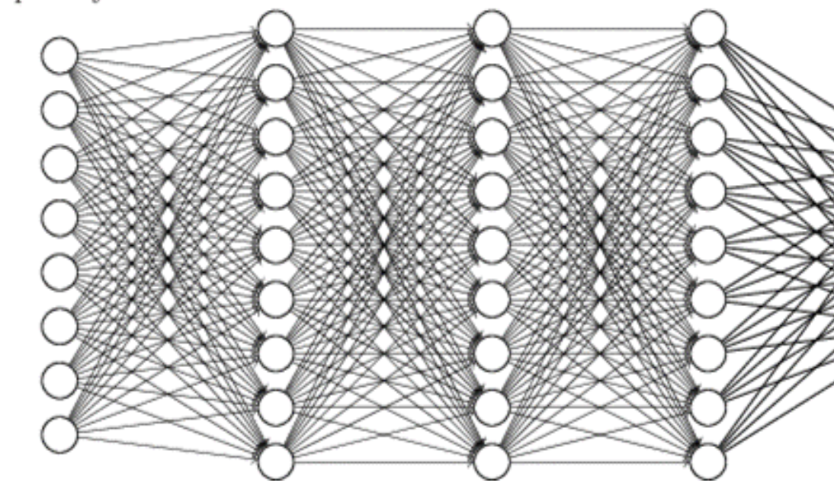
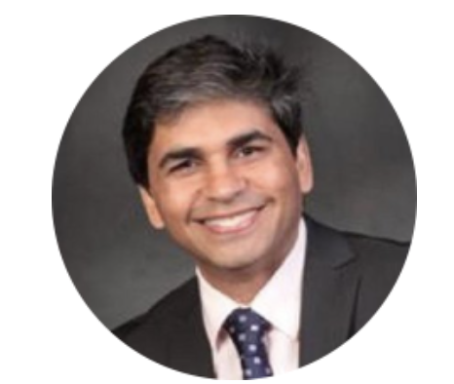
31 May 2018
Seminar: Artificial Intelligence:
application in life and health sciences
Tarry Singh
11.00-12.00 Victor Haderup Auditorium
Deep Learning Workshop: Getting started
*Registration required (contact Gopal)
Tarry Singh
14.00-16.00 Greenhouse seminar room 6.2.09
1 June 2018
Digging Deeper: Code along with Tarry
*Registration required (contact Gopal)
Tarry Singh & Gopal Karemore
10.00-16.00 Greenhouse seminar room 6.2.09
Target Audience: Entire KU community with no prior coding experience
Goals: Acquire elementary Deep Learning skills, gain understanding of advanced techniques in machine learning
Tarry Singh@deepkapha.ai
17+ years Head of Data Science, Entrepreneur,
Mentor Deep Learning @Coursera, AI & Neuroscience Researcher
& Enthusiast + Analytics Executive, https://tarrysingh.com/
Contact:
Gopal Karemore, PhD
Image & Data Analysis Expert
Novo Nordisk Center for Protein Research and Stem Cell Biology
gopal.karemore@cpr.ku.dk

